Slide 1
Power BI Project
Sales Analysis

Slide 2
Data Explanation
I created the dataset by myself using excel.
6 tables (Customer, Restaurant, Driver, Delivery, Order, Market).
100 Rows.
33 Columns.

Slide 3
Business Questions to Answer
What is the total revenue Daily, Monthly and Yearly?
What is the highest ordered food items by each month in a year?
Which day of the week is the orders high?
What is the revenue by day of the week?
Forecast revenue for the next upcoming week.
Forecast revenue for upcoming month.

Slide 4
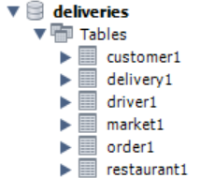
Import the Excel files
In Power BI I accessed the data using MySQL Database.
I started by creating the schema using MySQL Workbench.
I imported the excel csv files:

Slide 5
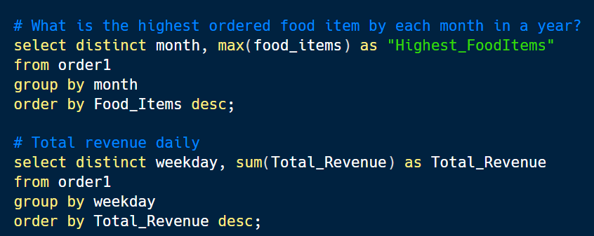
SQL Queries
I answered business questions by writing SQL queries:

Slide 6
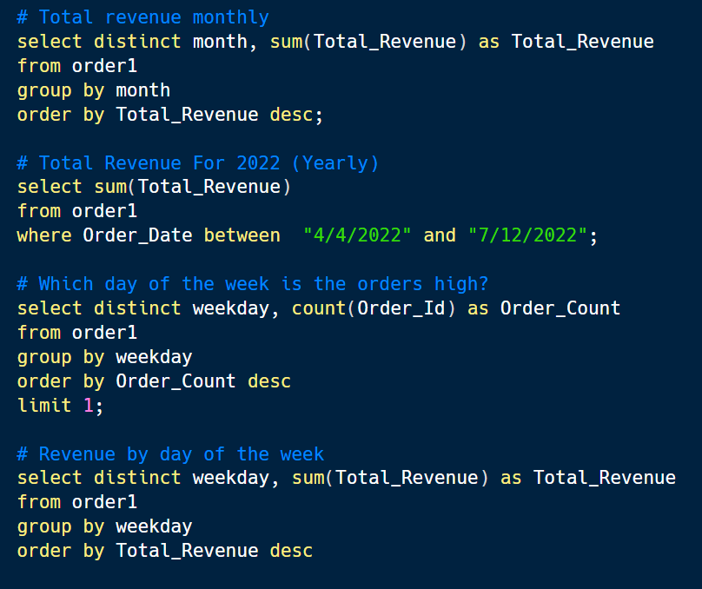
SQL Queries

Slide 7
MYSQL Database to Power BI
After writing the above queries,
I accessed MYSQL database from Power BI to create a dashboard and
here was the outcome:

Slide 8
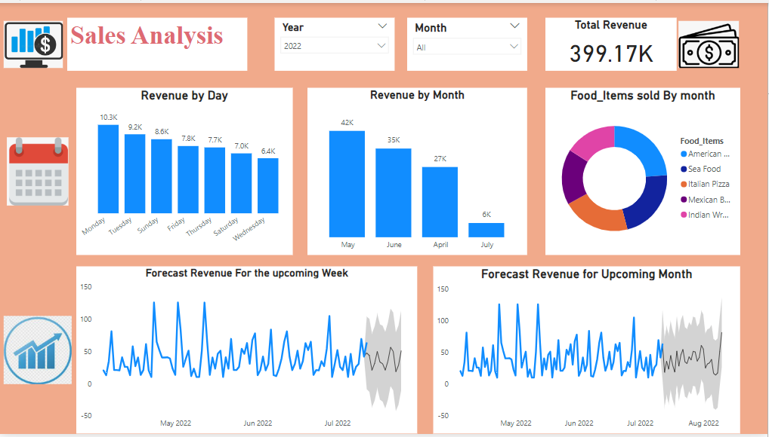
Dashboard

Slide 9
Findings
Overall,
The total revenue for the year is 399.17 K.
May is the month that has the higher revenue: 42 K.
During April and May we have a huge amount of American Burgers' orders and in June and July, the Sea Food is ordered more.
Monday remains the day of the week that has higher order with a revenue of 10.3 K.
Based of the previous orders, for the upcoming week we expected high sales on July 16, July 21 and July 25.
And for the upcoming month, on August 5 and August 10.

Slide 10
Thanks For reading
Don’t forget to comment and add more insights

